Slide 1



Slide 2


Agenda
Purpose of Web API
Available operations
Security
Demo
Q&A

Slide 3





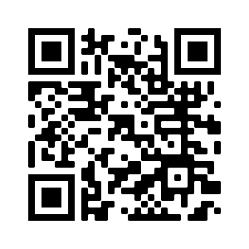



About me
https://www.dancingwithcrm.com/
https://www.linkedin.com/in/dancingwithcrm/
https://twitter.com/dancingwithcrm
https://github.com/OOlashyn

Slide 4




Web API
UI/UX
Portal version 9.3.3.X +
Format of Web API is similar to Dataverse API
Not for integration purpose

Slide 5





Web API
Operations
Create
Update
Delete
Associate
Disassociate

Slide 6


Web API
Operations – Release Wave 2 2021
Read
Custom Actions

Slide 7




Web API
Operations
POST
PATCH
DELETE
PUT
Creating entities and calling actions.
Use when updating entities or doing upsert operations.
Use when deleting entities or individual properties of entities.
Use in limited situations to update individual properties of entities.

Slide 8

Web API
Limitations
Web API doesn’t support
working with portal configuration entities
File and Image type fields
Choices field type

Slide 9




Web API
Security
Table Permissions
Per field configuration
CSRF token
GDPR

Slide 10

Web API
Configuration
Site Settings:
Webapi/<table name>/enabled
Webapi/<table name>/fields
List of fields logical names, coma separated
Use * for all attributes
Webapi/error/innererror

Slide 11

DEMO

Slide 12

Q&A

Slide 13

Thank you!

